Slide 1


Global Front Office Solution Approach

Slide 2
Agenda
Vision & Objectives
Current system view
Proposed System: Solution Components
Deployment architecture, Business scenarios and Release Plan
Our Proposal
Success Stories

Slide 3


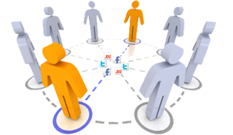



Vision & Objectives
Business
Employees
Enable expansion into new markets
Reduce time to market
Better decision making capability and control
High productivity
Better work/life balance
Customers
Ideal Technology Solution
Enhanced user experience
Simplified process flow
Any device accessibility
Partners
Improved investments
Increased participation
Stakeholders
More accountability
Detailed reporting
Healthier lives
Highest Quality Products
Deeper Social reach

Slide 4
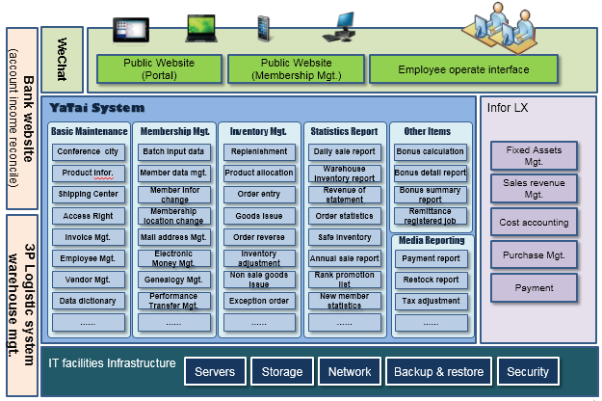
Current System View
Software
Obsolete application architecture
Lack of optimization
Monolithic design & architecture
Infra
Scalability limitations
Low reliability
Operation
Inefficient processes
Manual deployment

Slide 5
Proposed System: Solution Components
Notes:
Section Breaker Slide
Use this slide for a section heading. You may also add a sub heading. Both section name and sub heading cannot exceeding one line.
Section Name – 48, Calibri, should not exceed one line
Section Sub Heading – 24, Calibri, should not exceed one line

Slide 6
Path to Transformation
System Limitation | Our Solution | End State
Obsolete architecture | SOA for Self Contained Micro Services that integrates seamlessly thru an integration platform | Scalable Architecture leading to the Business growth
Monolithic design | Modular, component based design in which new subsystems will be integrated through Enterprise Integration Frame Work(Apache Camel) | Deliver quality functionality at accelerated rate; Minimize the development cost
Scalability issues | Horizontal scalability ; MemCache – Cache highly expensive and frequently used queries | Addressing the exponential growth seamlessly
Low reliability | Non sticky sessions for high availability and less down time; Flexible and Reliable Cloud Platform | Highly Available and Reliable Infrastructure Platform
Inefficient processes | Process re-engineering | Simplified workflow leading to the transformation roadmap
Deployment and Roll out to New Geos | Incremental changes to services without requiring shutdown or other disturbance to system availability | Enable rapid business innovations

Slide 7
Filling The Gaps
Scalability
Extensibility
Maintainability
Self sustainable and self contained services
(SOA architecture)
Efficient service discovery through Apache Zookeeper
Horizontal scalability
Loosely coupled components and layers
Non sticky sessions for high availability and less down time
New subsystems will be integrated through Enterprise Integration Frame Work(Camel)
Incremental changes to services without requiring shutdown or other disturbance to system availability
Management -- Monitoring, Load balancing, failover, configuration & deployment.

Slide 8





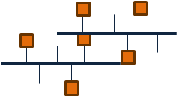

Component View
Cross Cutting Concerns
Portal
Access Channel
Build & Deployment
App Monitoring & Management
Information publish
Company profile
Membership mgmt
Search engine
Content mgmt
Access Integration
Application system
SaaS
Front Office
Back Office
Order initiation
Membership mgmt
Pricing
Inventory mgt
Order processing
Identity Mgt.
Service Fee
Promotion engine
Loyalty mgmt
Invoice mgmt
General Ledger
Manufacturing data mgmt.
Dev./Tst/Stage Platforms
Real time Log mgt.
Logistics
Storehouse Inventory
Genealogy
Payment processing
AR
AP
Access Mgt.
Tax Calc.
Employee mgmt.
Source control
App Monitoring.
Campaign mgmt.
Identity mgmt.
Purchasing mgmt
DRP
Application Security
Service Coordination /
Discovery (Zookeeper)
Service Integration
(Apache Camel)
Enterprise Service Bus
(Infor ION)
CI
Configuration mgt.
Exception Mgt.
CD.
Analysis
& Report
(BI)
DW
Master Data Management (MDM)
Release Mgt.
IT Infrastructure
Cloud Based

Slide 9


Technology Landscape
CDN
Cloudflare
Desktop Clients
Mobile Clients
Web Clients
Application Layer
Infor LX
Web Gateway
Adobe AEM
Service Interface
Service Interface
AdobeSearch
Infor LX
Service Implementation
Service Implementation
Database
Callidus
Cache Layer
Memcache
Memcache
Memcache
Service fee calculation
Integration Layer
Apache Zookeeper
Apache Camel
ION ESB
Analysis
& Report
(BI)
DW
Data Layer
My SQL
Mongo DB
File Storage Service
Master Data Management
Analytics Service - Adobe Omniture
Tax Calculation - Vertex

Slide 10
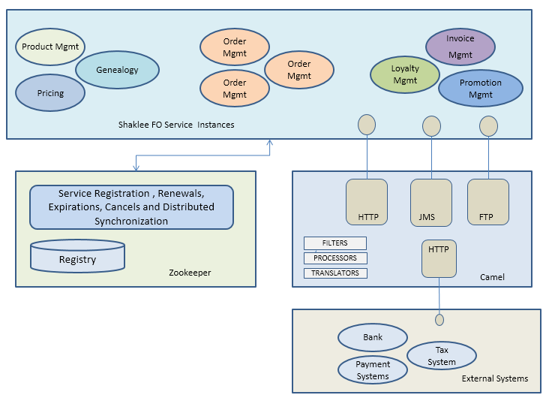
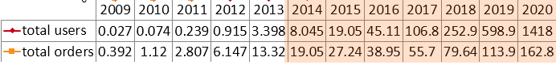
Scalability
Loosely coupled multidimensional scalable components
Optimized peer to peer network performance
Stateless JAX-RS web service interfaces
Service discovery and configuration using Apache Zookeeper
Leveraging Apache Zookeeper a Reliable, Scalable Distributed Coordination System
Unit: 100K
The shadow is an estimated data

Slide 11
Extensibility
Interoperable Components
Reliable messaging system, used to allow the service containers to interact
Messages / Data that are exchanged between containers using standard message exchange patterns
Message transformation and Routing services
Comprehensive message exchange patterns
Efficient Service Registration and Discovery (Zookeeper)
Service integration, Discovery and Orchestration

Slide 12
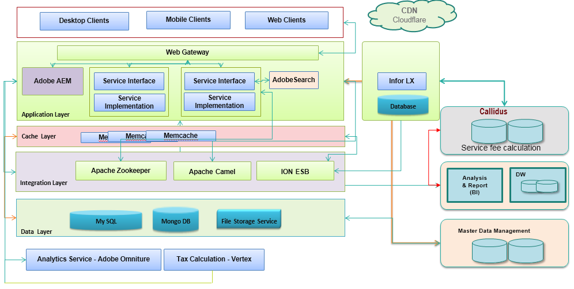
Maintainability
Modular and composable components
Complexity is encapsulated
Abide by the standard compliance
Supportability - common and popular methodologies to support the system
Functional Decomposition

Slide 13
Master Data Management
DATA INTEGRATION
(EAI, ETL)
Product Management
REFERENCE DATA
Product
Master Data Management
Govern
Share
Cross Communication
Consolidate
Price
Pricing Management
DATA FLOW
Customer
Customer Management
Vendor
Genealogy Management
Transactional Database
Master data management
DATA GOVERNANCE AND INTEGIRTY
Define the Reference Data Elements
Ensure data integrity between sub systems of Global Front Office
Manage governance, risk, and compliance by eliminating inconsistencies in core business data
Foundation for Data Warehousing and Business Intelligence

Slide 14
Rapid Global Rollout leveraging Duplicability
Pricing
Customer service
Order processing
Procurement
Promotion engine
PLM
Inventory management
Logistic integration
Ledger
Performance management
Tax calculation
Master
data management
Manufacturing
Payment integration
Business Analysis
Service Fee
Bank reconcili-ation
Global
Regional
Local

Slide 15
Deployment Architecture – Leveraging economies of scale
Notes:
Section Breaker Slide
Use this slide for a section heading. You may also add a sub heading. Both section name and sub heading cannot exceeding one line.
Section Name – 48, Calibri, should not exceed one line
Section Sub Heading – 24, Calibri, should not exceed one line

Slide 16
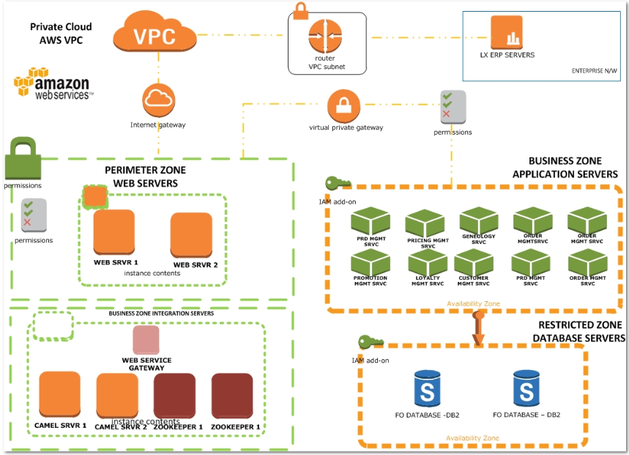
Private Cloud Approach
Increased Security – Security Groups & n/w ACLS
Aligned with the following security Standards
SOC 1, SOC 2, SOC 3
FISMA, DIACAP, and FedRAMP
PCI DSS Level 1
ISO 27001
ITAR
FIPS 140-2
AWS Identity and Access Management (IAM) to allow users, services, and applications to use the Amazon VPC resources
Resource-level permissions using EC2 API Actions
Leveraging Amazon’s built-in security features
Continuous Integration , Continuous Deployment tools that can leverage AWS API
Notes:
Ref: http://docs.aws.amazon.com/AmazonVPC/latest/UserGuide/VPC_Security.html

Slide 17
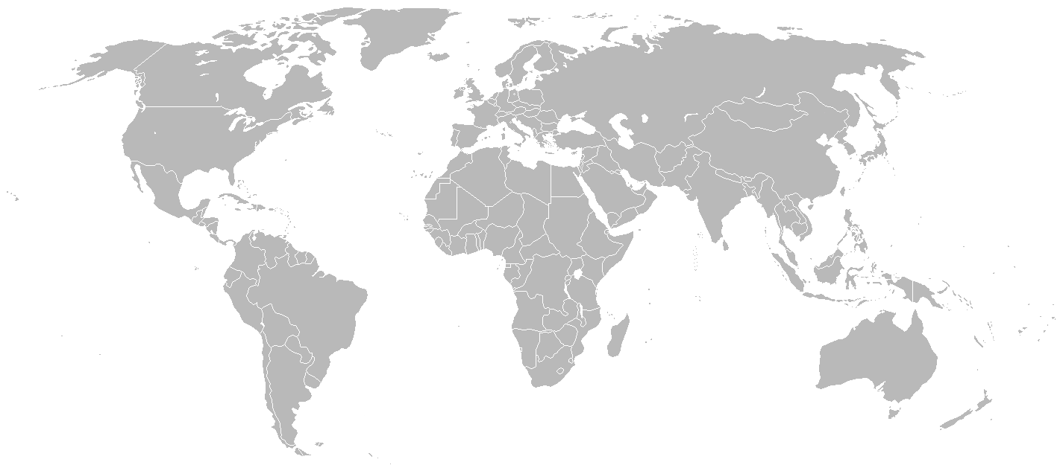
Public Cloud Approach: Scalable Geo Deployment
Hosted DR
Web
AWS - Singapore
App
AWS- China
Web
DB
Data
Web
App
DB DR
App
Data
MDM
Data
Web
Data Replication – Real time over VPN
App
Data
Leverage the Public Clouds
Leverage Web and App layer stacks for Compute – Enabling global reach
Databases hosted on China private cloud connected via VPN Tunnels
Benefits :
Scalability – Horizontal Web + App Tiers, Cost effective – Pay per Use model
Data Privacy – Restricted GoeDB hosted in Private Cloud

Slide 18
Business scenarios
Notes:
Section Breaker Slide
Use this slide for a section heading. You may also add a sub heading. Both section name and sub heading cannot exceeding one line.
Section Name – 48, Calibri, should not exceed one line
Section Sub Heading – 24, Calibri, should not exceed one line

Slide 19








Shopping cart
Freight Charges/Jiabi points
Order/Member details
Member
Payment status
ERP
DB
Front office
Product Management system
3rd party logistics
Total tax
Payment gateway
Master data management system
Flat Price
Tax calculation system
DB
Pricing system
Tier Price
Checkout
Add to cart

Slide 20
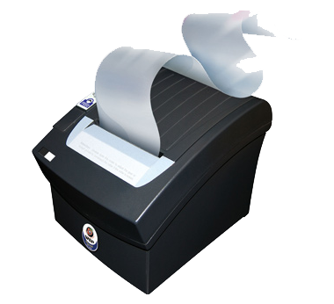
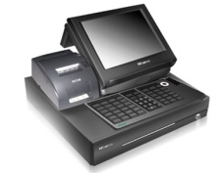


Invoice management
Front office(sales module)
Handover to member
POS
Invoice printer
Tax System
Invoice management platform
In store purchase
Online/batch invoice data upload
Membership portal
Invoice data transfer
3rd party logistics system
Payment gateway
ERP
Handover to member
DB
Online purchase
Order fulfillment request
Front office

Slide 21


Order Management – Component view
Responsive web design
Front Office
HTTP
Self-contained
Micro service
Order Management service
Web
App container
Member
Order Placement/
Initiation
Tx. DB Schema
Seamless Integration
HTTP
ERP
DB
Effective reporting
Camel
Scalable
Less latency
Maintainable
Highly available
Modular
File Adapter
ION
3rd party logistics
Business Intelligence/
Data warehousing
Asynchronous communication
Data governance
DB
MDM
DB
Back Office

Slide 22
Release Plan, Delivery methodology and Current status
Notes:
Section Breaker Slide
Use this slide for a section heading. You may also add a sub heading. Both section name and sub heading cannot exceeding one line.
Section Name – 48, Calibri, should not exceed one line
Section Sub Heading – 24, Calibri, should not exceed one line

Slide 23
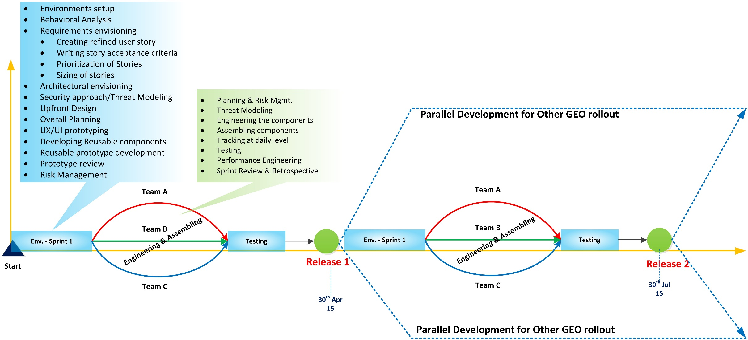
Release Plan – Global Rollout
Envisioning
Engineering & Assembling

Slide 24






Envisioning Phase for Global Rollout
Abhijeet/Deepa
3/2 – 3/21
Abhijeet/Deepa
3/2 – 3/21
Abhijeet/Deepa
3/2 – 3/21
Rajeev
3/9 – 3/21
Abhijeet/Deepa
3/2 – 3/21
On Hold
Ujjawal
3/9 – 3/21

Slide 25
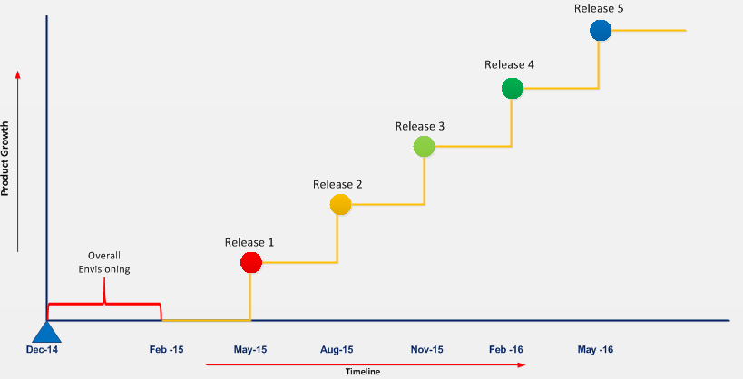
Release Plan – China Rollout
Stage | Release Scope
Overall envisioning | Initial requirements gathering,Application Architecture Orchestration layer (Zookeeper, Camel integration) Web gateway (HAProxy / Varnish / Squid / Ngnx) Building core app framework
Release 1 | Membership Management Genealogy CMS Product Management Pricing System Tax Integration
Release 2 | Shopping Cart Payment System Order Mgmt System Gift
Release 3 | Promotion System/Engine Invoice Mgmt System
Release 4 | Inventory Management System VAT invoice Management FO Reporting Access Control
Release 5 | Public Website Branch and Territory Mgmt Identity Management

Slide 26
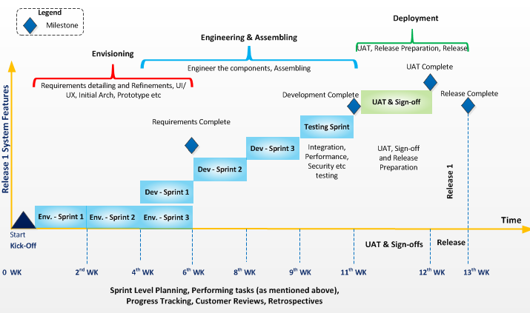
Delivery Methodology

Slide 27
Resource Tracker & Burn Down
Role | Resources required(#) | Resources confirmed(#) | Resources On-boarded(#) | Location
Project Manager Onsite | 1 | 0 | 1 | Beijing
Scrum Master | 1 | 0 | 1 | India
Technical Architect | 1 | 0 | 1 | Beijing
Java Tech lead | 3 | 0 | 2 | India
Java Developer | 9 | 0 | 8 | India
ION Engineer | 1 | 1 | 0 | India
QE Automation | 6 | 0 | 6 | India
Performance & Load Engineers | 2 | 0 | 2 | India
DB Schema designer & Migration (PLSQL Script) | 2 | 1 | 0 | India
UI | 3 | 1 | 0 | India
BA Onsite | 1 | 0 | 1 | Beijing
BA Offshore | 1 | 0 | 1 | India
Dev-Ops (RE) | 2 | 0 | 0 | India
Role | Count(#) | Duration (# mths) | Efforts(# hrs) | Individual Burndown
PM | 1 | 3 | 120 | 360
BA | 2 | 3 | 120 | 720
Technical Architect | 1 | 3 | 120 | 360
Java Lead | 3 | 3 | 120 | 1080
Java Developers | 9 | 3 | 120 | 3240
QE Automation | 2 | 3 | 120 | 720
QE Manual | 6 | 3 | 120 | 2160
Release Engg | 2 | 3 | 120 | 720
Data base Developer | 2 | 3 | 120 | 720
HTML | 3 | 3 | 120 | 1080
ION Engg | 1 | 3 | 120 | 360
Tentative total Burn down for next 3 months(# hrs) |  |  |  | 11520
23 out of 33 required resources on-boarded
Confirmed resources are to complete the formality to get on-boarded

Slide 28
Proposed System Components: Our Proposal
Notes:
Section Breaker Slide
Use this slide for a section heading. You may also add a sub heading. Both section name and sub heading cannot exceeding one line.
Section Name – 48, Calibri, should not exceed one line
Section Sub Heading – 24, Calibri, should not exceed one line

Slide 29




The Key Enablers
S
M
A
C
Social
Mobility
Analytics
Cloud
Our social platform can provide a more engaging content and collaborative tools to promote network marketing
Our responsive front end allows any device computing. An integral component to enhance customer/member/employee experience
Analytics tools drive organizations to put business intelligence into the hands of managers
By leveraging PaaS for application development we offer the best in class solutions

Slide 30
Any device computing @ Altimetrik
Products
Mobile Development
Domain association
Solutions and Frameworks
User management platform – Data capturing platform for user management
Altifin – Unified platform enabling agent based banking and CBO monitoring encapsulating mobile wallet & mobile banking
Application Development
Mobile test automation
Application Modernization
State-of-the art UX and designs
Platform agnostic development
On going maintenance and enhancements
Payments / Financial Services
Consumer Electronics
Life Sciences
Public Sector
Non Profit
Healthcare
Automotive
Adaptive Development Framework
Appcentric - Remote test on real devices and platforms
Framework of Interaction Mechanics
Integrated Prototyping Environment
Altishell Framework
Experience
Thought leadership and mind share providing meaning full solutions
150+ dedicated mobile technology professionals for global customers
State of the art mobile UX design team delivery ground breaking designs
Access to over 200 devices at our test lab
Dedicated innovation lab to foster next gen solutions and frameworks
Competency

Slide 31
Enterprise Mobile security
Device security
Application security
Network security
Data security
Consistent app security
Tracking & management of all mobilized apps
Federated identity & SSO
Enterprise access to mobile users without managing the whole device
Centralized management
Mobile device platform fragmentation
BYOD vs. company issued device
Comprehensive access and control policies using end point analysis and user roles
Highly scalable network access architecture
App or data containers – the enterprise mobility industry’s response to data leakage
Secure alternative to tools that solve user’s problems
Challenges
Technical consultation on best fit MDM(mobile device management) strategy
Proposed MDM deployment for leading US based automobile manufacturer
ADF framework providing libraries for in-app security
Implemented geo fencing based app access. Expertise in latest security enhancements in iOS & Android
AltiShell solution providing end to end transport security with both server and client end point encryption
Proposed a fully HIPAA compliant architecture for healthcare platform
On device data encryption/decryption and secure storage with micro hub component
Developed a background secure data sync framework for healthcare application
Altimetrik’s solution/
Expertise

Slide 32
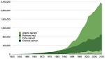
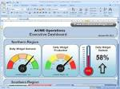
BI Solution Architecture for Shaklee
Source Data Stores, Files, Systems, etc.
Front Office
Back Office
Data / Reports Security
Order initiation
Membership mgmt
Pricing
Promotion mgmt
Loyalty mgmt
Fixed asset mgt
Order processing
AR
Storehouse Inventory
Invoice mgmt
Genealogy
Product mgmt
General Ledger
Manufacturing
AP
USA
China
India
Japan
Other Countries….
ETL Layer
Data Management Standards
Staging DB
Control & Metadata
Staging DB
ETL Layer
Metadata
Staging DB
Control Data
Metadata
DW DB
Data Marts
Control Data
Reports & Devices / Channels

Slide 33
BI/DW Solution Development SDLC
Requirements Gathering
DW/BI Architecture
DW/BI Data Model
ETL Design
Analytics Design
Requirements Gathering
DW/BI Architecture
ETL Design
Analytics Design
Performance Management
Analytical Reporting
Identify Data Sources, Files, Structures, etc.
Owners / Stake holders
Reports & Dashboards
Non Functional Requirements
Retention, Compliance Requirements
ETL Requirements
Security
Reliability
ETL Architecture
Application Architecture
Identify the Tools, Platforms & Technologies
Identify Loading Methodology (ETL or ELT)
DW/BI Data Model
Target DW
Master Data Management
Identification
Management
Logical & Physical
Data Profiling
Data Marts
Data Masking
Data Classification (PII, PCI, etc.)
Staging
Data Mapping
Reconciliation
Exception Handling
Load Design
Jobs / Schedule
Design Reports
Design Users, Roles & RBAC
Design for Mobile Devices Support
Analytics Design
Cube Design
Data Volume Design
Infrastructure for Data Growth

Slide 34
Our Recommendation
Technology Stack | Product / Framework | Recommended Platform | Reason for recommendation
Data Warehouse DB | On-Premise MySQL Teradata DW DB Cloud DW DB AWS RedShift | RedShift as the entire application is deployed on AWS Cloud | Native to application deployment environment Peta byte scalable DW DB Columnar Storage for better Query Efficiency and Parallelizing Query across multiple nodes Supports Standard Postgre SQL JDBC and ODBC drivers Integrates with Amazon S3, Amazon DynamoDB, Elastic MapReduce, Amazon Kinesis Encryption of Data @ rest and in transit using Hardware Accelerated AES-256 and SSL Fully managed environment Cost based on Pay-as-you-use model
ETL | Informatica or Talend ETL Platform | Talend ETL Platform | Ability to use Hadoop with minimal Java knowledge Act as code generation tool Provides flexibility to run code in any server with just java installation Supports all the widely used databases and also Hadoop eco-systems Available In-house experts on Talend Enterprise ETL tool
Reporting | MicroStrategy Tableau Pentaho Business Analytics | MicroStrategy | Robust SQL Engine which can glide through any data model giving easy drag and rop semantic layer Easy self-service mode for business users who can craft reports and drill freely Scalable in SQL optimization and options for Intelligent cubes (cache large amount of data) Best in-terms of report performance due to the Intelligent cube ability Mobile BI availability for business users to provide fancy demo to the end users Support email narrowcast of reports (report bursting technique)

Slide 35


Build Release Process in SDLC
Dev, Environment Setup
(Java, C++, IDE)
Update Status
BUG/FEATURE Travelling JIRA/RALLY
(success)
Dev Workspace
(Pull the code from GIT)
Code Coverage
(sonar/Coberturn)
CQ/JENKINS
RQA Build Regression Testing Batch Automated
Code Commit
GIT
Build Scripts
TEST SCRIPTS
Deployment Scripts
INTEGRATION TESTING
Trigger Build
Live
Approval
REPO- Artifacts Repository
LEGENDS:
Build Servers
TEST Servers
Dev VM Tool
1 Week
(Throttle)
AUTOMATION
FQA: 3-4 weeks
RQA: 2 weeks
MANUAL
Full 4-6 Hrs,
4-6 Hrs,
LEAD TIME
DURATIONS

Slide 36




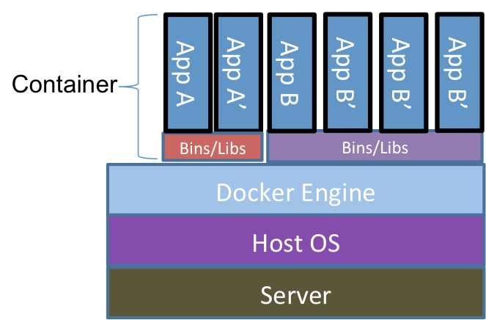







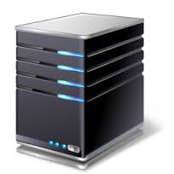





Continuous Delivery Model
1
Check out & build
3
4
Packer generate images for deploy and Docker encapsulate App stack
6
7
8
2
Vagrant Generates Consistent Environment
5
Build verification Test
Unit Testing
Integration Testing
Store the valid binaries in Artifactory
Deploy to Pre-prod
5
1
3
Prep build environment
6
7
8
Compile
Self-service Ops for Dev/Test
Package
4
2
Packer

Slide 37
Success Stories
Notes:
Section Breaker Slide
Use this slide for a section heading. You may also add a sub heading. Both section name and sub heading cannot exceeding one line.
Section Name – 48, Calibri, should not exceed one line
Section Sub Heading – 24, Calibri, should not exceed one line

Slide 38
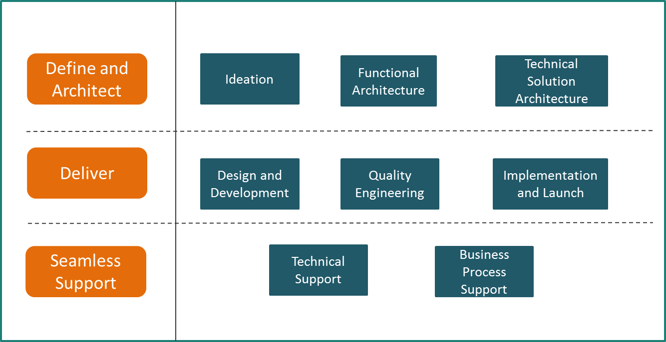
E2E Implementation for Leading Payment Provider
Business Case
Altimetrik Solution
To provide end-end financial inclusion solution to unbanked and under banked citizens of India
Enable biometric KYC authentication based on Indian Government’s Aadhar UID
Provide support on Business Process operations for Financial Inclusion initiatives
E2E implementation and support, from Ideation to Business process support, of a PC-PoS based solution to enable financial inclusion transactions
Biometric KYC authentication based on Indian Government’s Aadhaar Unique Identification
Channel Expansion and Market Penetration using Aadhaar (Unique Identification Number) based payment processing
Combined ‘Go-To’ Market strategy with Unique Identification Authority of India (UIDAI) and 5 Leading Banks in India
Design and developed an Admin portal to manage the Onboarding of Banks & Business Correspondents
Business Benefits
First of its kind solution launched directly by the government of India for Financial inclusion
Have on-boarded around 1700 bank branches, associated Business Correspondents and 100 financial agents and associated Business Correspondents
Enabled ~35,000 biometric KYC authentication transactions through leading Banks in India (ICICI, HDFC and Bajaj Finance) and Banking Correspondents
Nimble and flexible to provide E2E Business operations support to ensure seamless operations of this Financial Inclusion platform
Financial Inclusion Solution Features
Balance Inquiry
Cash Withdrawal
Cash deposit
Purchase transactions
3rd party deposits
Biometric authentication
A/c Opening
New card issuance
Funds Transfer

Slide 39
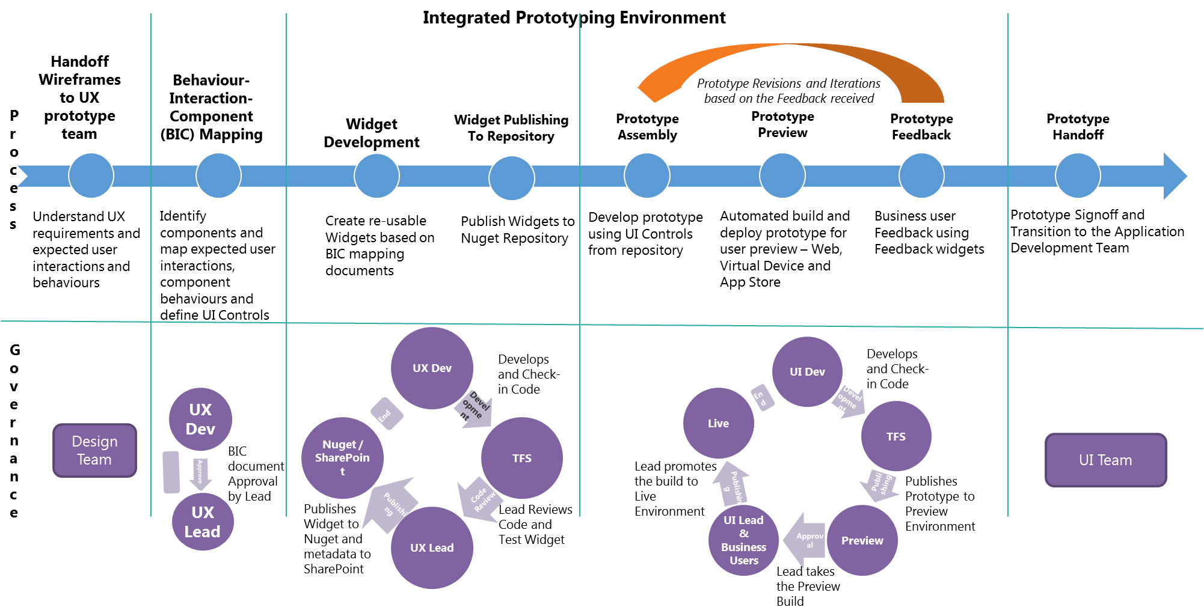
Enhanced User Experience Using IPE
Client Profile: A Leading Financial Services Provider in USA
Business Case
Altimetrik Solution
No mechanism to easily translate User Experience in to UI application pages
Prolonged User Experience Review Process
Throw Away Code resulting in rework
Leveraged in-house Integrated Prototyping Environment (IPE) solution to enable rapid creation of reusable prototypes, by capturing the intended user experience and reducing development effort.
Business Benefits
Standardized and consistent user experience
Accelerated reusable UI Development by 40% with a reusable interaction repository
Reusable, plug and play, HTML 5 widget repository driven by behaviour driven interaction mechanics
IDE integrated tooling for prototype development
Handoff of reusable prototype code to app dev teams

Slide 40


Salesforce Social Integration
Highlights
Force.com expertise allowed quick delivery of high quality application.
Users can search and monitor Tweets and Fan Page Posts to find relevant customer service conversations.
Capture, monitor, and respond to those conversations - all from the Salesforce Service Cloud.
Altimetrik helps a Global Cloud Computing Company track Customer Conversations on Social Channels

Slide 41

BI Solution for Payment Provider
Highlights
Highlights
Created 20+ dashboards with all advanced features in micro strategy
Support for all devices
Self-service analytics
Security – Integrated with enterprise LDAP
Access control based authorization for all the reports
User Prompts based Solution for Filtering Data based on User IDs (Integrated with LDAP also for automatic identity integration)
Force.com expertise allowed quick delivery of high quality application.
Users can search and monitor Tweets and Fan Page Posts to find relevant customer service conversations.
Capture, monitor, and respond to those conversations - all from the Salesforce Service Cloud.
Altimetrik delivered an end-to-end BI solution for one of the leaders in Payment Industry

Slide 42

Thank You
Partnering for Business Transformation
Notes:
Thank you Slide with customer / partner logo
Use this slide if you need to create a presentation in partnership with a customer. Logo placements should not be changed.
Thank you – Font size 44, Calibri
Name – Font size 18, Calibri, cannot exceed one line
Designation – Font size 14, Calibri, cannot exceed one line
Email – Font size 12, Calibri,cannot exceed one line

